Slide 1

Meetings 1-8
Shared Parenting
sponsored by the
New York State
Office of Children and Family Services
through a training and
administrative services agreement with the
Research Foundation for SUNY
SUNY Buffalo State
Center for Development of Human Services

Slide 2
Meeting 1
Finding a Way
to Share
© 2014 New York State Office of Children and Family Services.

Slide 3
Warm-Up Activity
Create a brief written or graphic description of a time in which your child stayed with another person for at least a week.
Demonstrate any issues that
arose as a result of differences
in your approach to parenting.
(Be as creative as you can.)
You will have 10 minutes.

Slide 4
Parents in the Video (1 of 2)
Rob & Liz: Parents of a two-year-old boy in foster care.
Bonnie: Grandmother of a 14-year-old boy in foster care.
Roxann: Mother of two girls who were in foster care when she was in prison.
David: Father of two girls who were
in foster care, and baby who is not
in foster care.

Slide 5
Parents in the Video (1 of 2)
Thomas: Father of a ten-year-old girl who was in foster care.
Lashon: Voluntarily placed her two children who now live with her.
She is recovering from addiction.
Debbie: Mother of a two-year-old
boy who was placed with her sister.
She is recovering from addiction.

Slide 6
Instructions for Discussing the Video
As you view the video, make notes on the worksheet.
After being divided into small groups, select a group facilitator.
Select a group recorder/reporter.
Be prepared to report to the
large group. (10 Minutes)

Slide 7
Meeting 2
Challenges to Partnerships
in Parenting
© 2014 New York State Office of Children and Family Services.

Slide 8
Characteristics of the Family System
Boundaries
Rules
Roles
Power Distribution
(Decision Making)
Communication Patterns

Slide 9
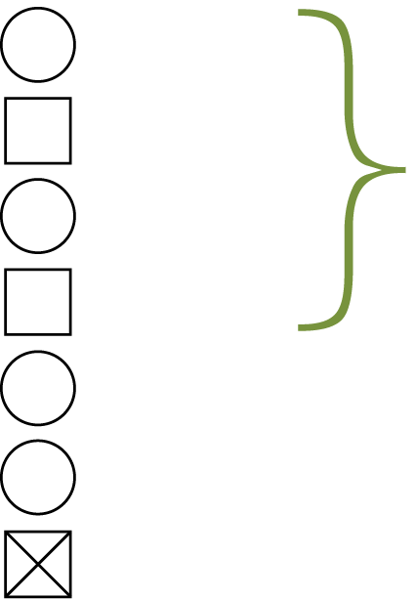
Family Mapping Legend* (1 of 4)
Female
Male
Relative size of the figures indicates apparent power
in the family
M
Mother
F
Father
14
Age (children)
A
14
Adopted 14-year-old daughter
G F
Deceased grandfather (Still important to family)
* Adapted from Edwards, John T. Child Welfare and Substance Abuse Interventions. Atlanta, Georgia: Child Welfare Institute, 1993.

Slide 10
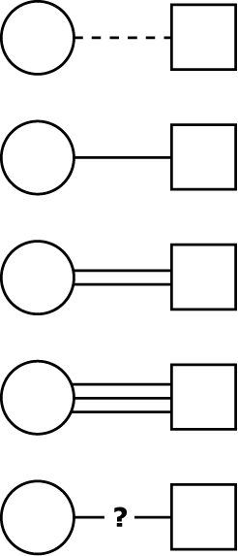
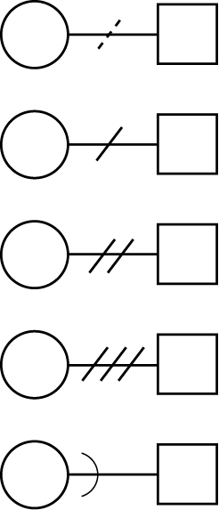
Family Mapping Legend (2 of 4)
Relationships are indicated by different lines between members:
Minimal connection
Unacknowledged conflict
Typical connection
Mild conflict
Stronger
than most connections
Moderate conflict
Enmeshed (unclear boundaries)
Heavy conflict
Nature of relationship
is uncertain
Family member
who is cut off through divorce, abandonment, prison

Slide 11

Family Mapping Legend (3 of 4)
Generational and group boundaries
are indicated in the following manner:
Generational line between parents and children
Flexible
group boundary

Slide 12

Family Mapping Legend (4 of 4)
Generational and group boundaries
are indicated in the following manner:
Rigid
controlling
group
boundary
Unclear, unprotected group
boundary

Slide 13
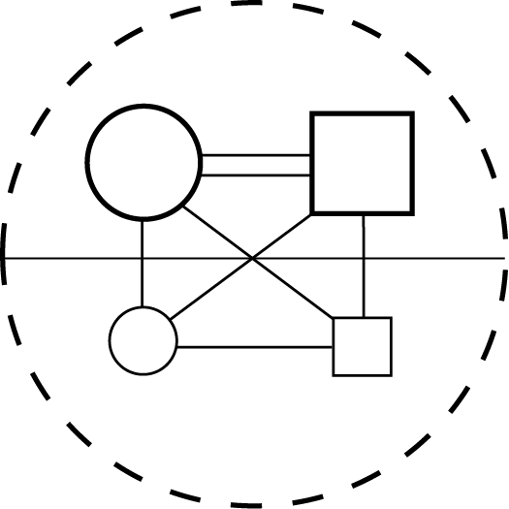
Examples of Family Maps* (1 of 3)
M
F
14
A
11
* Adapted from Edwards, John T. Child Welfare and Substance Abuse Interventions. Atlanta, Georgia: Child Welfare Institute, 1993.

Slide 14

Examples of Family Maps (2 of 3)
M
F
14
A
11

Slide 15

Examples of Family Maps (3 of 3)
M
F
14
A
11
8
F

Slide 16
Challenges to Shared Parenting
What are some of the challenges/ issues to permanency when family members or foster care systems assume the role of:
The Persecutor?
The Victim?
The Rescuer?

Slide 17
Directions for the Activity (1 of 2)
Select a facilitator, a recorder/reporter.
Discuss your best ideas
for managing each of the challenges assigned to
your group, then list them
on paper.

Slide 18
Directions for the Activity (2 of 2)
Focus on managing issues arising out of the conflicting boundaries, roles, rules, decision-making and communication patterns.
After 12 minutes, be prepared to share your
ideas to the large group.

Slide 19
Meeting 3
Making and Maintaining Boundaries
© 2014 New York State Office of Children and Family Services.

Slide 20
Physical Boundaries
Social Boundaries
Emotional Boundaries

Slide 21
Defensive Boundaries
Shared, Negotiated Parenting
Boundaries

Slide 22
Instructions for Small Groups – Part 1 (1 of 2)
Select a facilitator, a recorder/reporter.
Brainstorm a list of shared parenting boundaries
foster parents should
negotiate with parents of children in care. (5 Minutes)

Slide 23
Instructions for Small Groups – Part 1 (2 of 2)
Discuss how each listed boundary may help build relationships between both
sets of parents and ensure safety for children. (8 Minutes)
Rank each boundary from
the most important to the
least important. (2 Minutes)

Slide 24
Instructions for Small Groups – Part 2 (1 of 2)
Select a NEW facilitator, a recorder/reporter.
Select at least two prioritized boundaries in the previous activity and identify at least two ways to maintaining
each boundary.

Slide 25
Instructions for Small Groups – Part 2 (2 of 2)
Decide upon an effective consequences for each boundary if it is broken.
Be prepared to report back
in 10 minutes.

Slide 26

Meeting 4
Partnering With Parents
Who Have Alcohol and
Other Drug Problems
© 2014 New York State Office of Children and Family Services.

Slide 27
Instructions for Warm-Up Activity (1 of 2)
Find a partner.
Introduce yourselves to each other.
Describe the underlying need
of someone you know who has
a substance abuse problem.

Slide 28
Instructions for Warm-Up Activity (2 of 2)
Ask your partner for an idea about how to meet the underlying need.
Be prepared to introduce yourself and share one word or
a short phrase that summarizes the need you identified to your partner. (6 minutes)

Slide 29

Cycle of Need
Need
(Underlying
Condition)
Relaxation
Expression
(Behavior)
Nurture
Social
Control
Intervention

Slide 30
Impact of Chemical Dependency on the Child Welfare System (1 of 5)
From 1985 to 1995, the number of children in the program formerly known
as Aid to Families with Dependent Children (AFDC) increased by 37% , from
7 million to 9.4 million.

Slide 31
Impact of Chemical Dependency on the Child Welfare System (2 of 5)
During the same decade,
the number of children in foster care rose by 79%, from 276,000 to 494,000.

Slide 32
Impact of Chemical Dependency on the Child Welfare System (3 of 5)
Cases of child maltreatment and neglect have been steadily increasing also. There were 60,000 cases of children maltreatment and neglect reported in 1974; 1.1 million
in 1980; 2.4 million in 1990; and 3.2 million in 1995.

Slide 33
Impact of Chemical Dependency on the Child Welfare System (4 of 5)
Between 1986 and 1995, cases of child maltreatment and neglect increased
by 49%.
Crack became accessible after 1985. Crack is a relatively inexpensive drug.

Slide 34
Impact of Chemical Dependency on the Child Welfare System (5 of 5)
While there are a number
of factors that influence these statistics, one of the primary factors is the increased incidence of parental alcohol and drug use, abuse and addiction.

Slide 35
A drug refers to
any substance that,
by its chemical nature, alters the structure or function of a living organism.

Slide 36
Criteria for Use, Abuse, and Dependence
Use
No Problems
Abuse
Control (choice)
Non-progressive
Dependence
Less than
100% Control (choice)
Progressive (continued
use despite adverse consequences)

Slide 37
Two Types of Dependence
Physiological
Psychological

Slide 38
Vulnerability Factors in Chemical Dependence
Agent
Availability
Cost
Addictive Properties
Host
Genetic Vulnerability
Personality/
Temperament
In-utero Variables
Physical/Mental
Health Concerns
Environment
Inadequate
Health Care
Life Events
Stressors
Coping Skills
Social Isolation
Racism
Poverty

Slide 39
Scoring Instructions (1 of 3)
One point for the Victim/Addict each time:
The Victim succeeds in getting the persecutor to admonish her.
The Victim succeeds in getting the Rescuer to taker care of her.

Slide 40
Scoring Instructions (2 of 3)
One point for the Persecutor
each time:
The Persecutor does not respond to
the Victim in a punishing, condemning, or accusing manner.
The Persecutor persuades the Rescuer not to rescue the Victim.

Slide 41
Scoring Instructions (3 of 3)
One point for the Rescuer
each time:
The Rescuer holds back and does not console or attempt to rescue the Victim.
The Rescuer persuades the Persecutor not to punish the Victim and to hold
the Victim accountable for her own behavior instead.

Slide 42
It’s No Mystery! (1 of 3)
There’s nothing very
mysterious about drugs.
Just remember:
Drugs do what people
expect them to do…that
is why people use them.

Slide 43
It’s No Mystery! (2 of 3)
Just remember:
People will use them
in spite of the negative consequences.
Drug use reflects the underlying needs of the person.

Slide 44
It’s No Mystery! (3 of 3)
Just remember:
If a person expresses a need through drug use,
we should respond to
the behavior appropriately.

Slide 45
The Disease Concept of Dependence
Primary
Chronic
Progressive
Fatal
Relapsing
Treatable, Not Curable

Slide 46
Models of Chemical Dependence
Moral
Learning
Disease
Self-Medication
Social
Dual Diagnosis

Slide 47
Relapse
Continued Use

Slide 48
Myths About Relapse (1 of 2)
Relapse
Is a sign of poor motivation.
Is a sign of treatment failure.
Is unpredictable and unavoidable.
Occurs only when patients
use their drug of choice.

Slide 49
Myths About Relapse (2 of 2)
Relapse
Is an instantaneous event
that occurs only when
patients actually take drugs
or drink again.
Erases or nullifies positive recover changes made
thus far.

Slide 50
Signs of Relapse
1. Set-ups
2. Feeling Cured After a
Few Weeks or Months
3. Desire to Test Control
4. Negative Moods
5. Exhaustion

Slide 51
Meeting 5
Fear and Control
© 2014 New York State Office of Children and Family Services.

Slide 52
Definition of Fear
Fear is an unpleasant, often strong emotion caused by anticipation or an awareness of danger.

Slide 53
Definition of Control
Control means to exercise restrain over; to direct influence over; or to have power over.

Slide 54
Group 1:
Foster Parents
Group 2:
Children in Foster Care
Group 3:
Parents of Children in Care
Group 4:
Caseworkers

Slide 55
Instructions for Small Group Activity – Part 1 (1 of 2)
Select a facilitator/reporter.
Discuss the possible fears
of the individuals your
group was assigned. Focus
on the fears most likely to affect partnerships between the parents.

Slide 56
Instructions for Small Group Activity – Part 1 (2 of 2)
List the fears you identified on a flipchart paper.
After 15 minutes, be prepared to report to the large group.

Slide 57
Cycle of Need
Need
(Underlying
Condition)
Relaxation
Expression
(Behavior)
Nurture
Social
Control
Intervention

Slide 58
Instructions for Small Group Activity – Part 2 (1 of 3)
Select a NEW facilitator/reporter.
Choose two fears from the previous list.
Identify the behavior associated with the two fears.

Slide 59
Instructions for Small Group Activity – Part 2 (2 of 3)
Develop intervention strategies foster parents could use to meet the
needs expressed by these behaviors while building
trust and nurturing their relationships with birth parents.

Slide 60
Instructions for Small Group Activity – Part 2 (3 of 3)
Use Handout 3 “Meeting Needs Strategy Worksheet”.
After 15 minutes, be prepared to report to the large group.

Slide 61
Control Theory
“Our lives are a continual
struggle to gain control in a way
that we can satisfy our needs and not
deprive those around us of satisfying theirs.
In the end, human beings have only one avenue, negotiation and compromise,
through which to work out a way
to live in harmony.”
William Glasser, M.D.

Slide 62
Meeting 6
Understanding the Impact
of the Adoption and
Safe Families Act (ASFA)
on Shared Parenting
© 2014 New York State Office of Children and Family Services.

Slide 63
Permanency Planning
Permanency Goals

Slide 64
1980
Adoption Assistance and
Child Welfare Act
1997
Adoption and Safe Families Act
(ASFA)
“Reasonable Efforts”

Slide 65
Concurrent Planning

Slide 66
Why now, more than
ever, must parents show
that they are serious?

Slide 67
What are some examples
of ways foster parents
might ‘set up’ parents to
make bad choices relative
to family reunification?

Slide 68
What are some techniques that you use to facilitate a shared parenting relationship and the reunification of parents with their children?

Slide 69
Instructions for Small Groups (1 of 2)
Select a group facilitator
to make sure everyone gets to talk.
Select a recorder/reporter.
Review your assigned case.

Slide 70
Instructions for Small Groups (2 of 2)
Answer all the questions as
a group, but only write your answers to #4 and #5 on
the flipchart paper. Be as specific as possible.
Be prepared to report to the large group in 20 minutes.

Slide 71
Meeting 7
Shared Parental Responsibilities
© 2014 New York State Office of Children and Family Services.

Slide 72
Responses to Sharing Parental Responsibility (1 of 2)
Briefly describe the experience you had, or imagined having, in which you were separated from your children.
What emotions do you
recall?

Slide 73
Responses to Sharing Parental Responsibility (2 of 2)
What concerns did you
have for your children?
How do you believe your experience is similar to
the experience of parents whose children have been
in foster care?

Slide 74
Interpersonal Helping Skills
Engagement
Genuineness
Empathy
Respect

Slide 75
Communication Skills (1 of 2)
Tracking skills – these are
skills that foster parents can use to follow the content and emotions of a conversation.
Accommodating skills – these
are skills that foster parents can use to communicate effectively with parents.

Slide 76
Communication Skills (2 of 2)
These skills include:
Eye contact
Posture
Facial
Expression
Gesture
Voice
Reflecting Content
Reflecting Feeling
Summarization
Concreteness

Slide 77
Guidelines for Sharing Parental Responsibility (1 of 5)
Plan enjoyable activities.
Plan activities that are age-appropriate for the children.
Consider the parents’ ability
to stay focused on a task, and consider the parents/hobbies
and interests.

Slide 78
Guidelines for Sharing Parental Responsibility (2 of 5)
Consider the parents’ ability
to recognize and encourage positive responses in their children.

Slide 79
Guidelines for Sharing Parental Responsibility (3 of 5)
If the parents do not know how to interact with their children in
a positive manner, the activity
in which the parents and their children are involved should be structured so that the parents and their children are not in
close contact all the time.

Slide 80
Guidelines for Sharing Parental Responsibility (4 of 5)
However, the parents and their children must have the experience of being involved in a purposeful and pleasurable activity in one another’s company. During the activity, parents should refrain from saying unkind words and feeling the need to discipline and control their children.

Slide 81
Guidelines for Sharing Parental Responsibility (5 of 5)
Consider the parents’ culture.
This includes:
– their use of language
– how they relate to people and the larger community
– their beliefs and attitudes/values
– their concept of time and time management
– their customs and their ways of communicating

Slide 82
Definitions of Risk and Safety (1 of 2)
Risk is the likelihood of any degree of long-term harm
or maltreatment. It does
not predict when the future
harm might occur, but rather, the likelihood of the harm happening at all.

Slide 83
Definitions of Risk and Safety (2 of 2)
A child is safe when there is
no immediate or impending danger of serious harm to
a child’s life or health as a
result of acts of commission
or omission (actions or inactions) by a child’s
parents and/or caretakers.

Slide 84
Comparing Risk and Safety
Time
Degree
of Harm
Purpose of
Invention
Safety
Now or very
near future
Only moderate
to severe
Control
Risk
Longer term
Low to severe
Resolve or
reduce

Slide 85
Meeting 8
Conflicting Family
Cultures
© 2014 New York State Office of Children and Family Services.

Slide 86
Directions for Introductions
Introduce yourself.
Tell us how long you have been a foster parent.
Tell us one interesting thing you learned about someone else in the group.

Slide 87
Culture
Race
Ethnicity

Slide 88
The Core Conditions of Helping
Genuineness
Empathy
Respect
© 2014 New York State Office of Children and Family Services.

Slide 89
Situations in
Which It Would Be
Difficult to Show
Respect to a Parent:

Slide 90
Shared Parenting
Thank You!
© 2014 New York State Office of Children and Family Services.

